Slide 1

Impact of climate variables on Covid-19 cases for New York and Sao Paulo (Does Covid19 spread faster in colder and drier weather ?)
Final Project - Data Analytics Bootcamp
University of Toronto
June 9, 2021
Presented By: Group 5
Aisha Syed
Archana Narula
Maria Leon
Sushmitha Maddali
Kushal Sharma

Slide 2
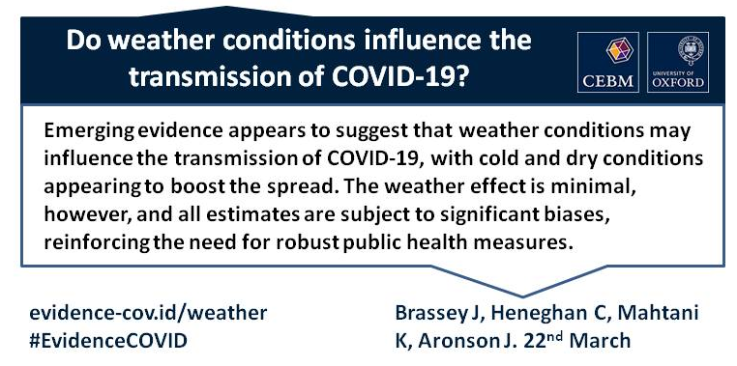

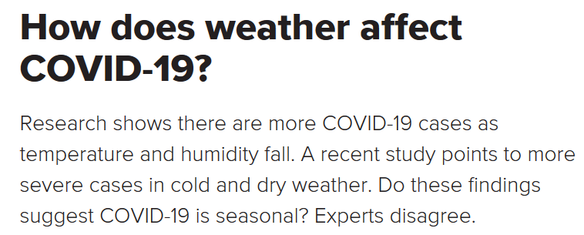
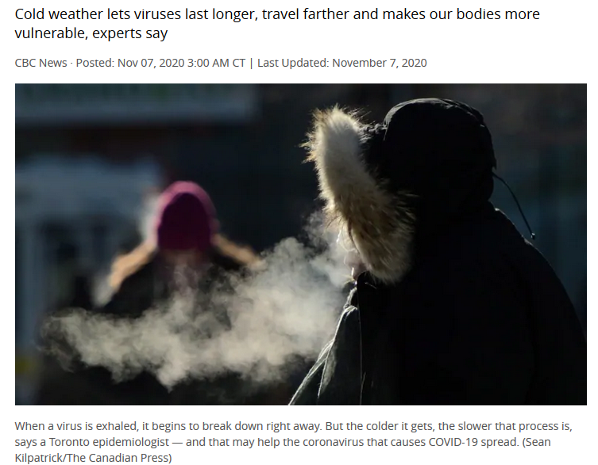
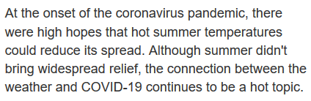
Overview
The new novel Coronavirus known as Covid19 (SARS CoV-2), has caused one of the most serious health crises globally. Since its global spread last year, we've seen multiple news article around the impact of temperature and humidity on the speed of spread and whether or not virus thrive in colder temperature. A simple Google search using term "covid spread cold and dry weather news" will lead to multiple articles from credible sources (statistical and scientific) in favor or against.
Purpose
The purpose of this study is to analyze if colder and dryer weather have any impact on Covid-19 virus
Notes:
Some of the key one published over the year are:
www.cebm.net on Mar 23,2020 Do weather conditions influence the transmission of the coronavirus (SARS-CoV-2)?
www.medicalnewstoday.com on Aug. 15,2010 How does weather affect COVID-19?
www.statenews.com on Oct. 21,2020 Covid-19’s wintry mix
www.sciencedaily.com on Nov. 2,2020 Hot or cold, weather alone has no significant effect on COVID-19 spread
www.cbc.ca on Nov. 7, 2020 Winter will help COVID-19 spread more easily
www.huffingtonpost.ca on Jan.7,2021 Does Cold Weather Make COVID-19 Spread More Easily?
www.ctvnews.ca on Sep. 20,2020 COVID-19 appears to spread less in warm and wet climates

Slide 3
DATA SOURCES
(Secondary Data)
PROJECT SCOPE
Limited to 2 cities
New York
Sao Paulo
Cities are selected based on similar population per 100,000, covid cases, weather differences covid response.
Covid cases data
Seade Foundation Statistics Agency of the State of Sao Paulo ^{[1]}
NYC Department of Health and Mental Hygiene ^{[2]}
Weather data
OpenWeatherMap^{[3]}
VARIABLES
LIMITATIONS & ASSUMPTIONS
Target
mavg_7day_per_100k_new_cases (7 days moving average of covid19 new cases for the city)
Standalone Study (Considers all other parameters were constant like testing, lockdowns, vaccinations, etc.)
Integrity of data sources (Data collections and reporting was reliable and neutral)
Weather data
mavg_15_temp (15 days moving average of temperature for the city)
mavg_15_humidity (15 days moving average of humidity for the city)

Slide 4


Exploratory Data Analysis
First Round of Data Discovery
Second Round of Data Discovery
4 datasets
3 datasets
Round 1
Round 2
Findings of Initial Review using Python
Weather data extracted from openwheathermap was reliable
Covid data had discrepancies for both cities
Frequent changes in formats of recording data causing data jitters
New sources were identified
Findings of Repeated Review using Excel
Covid 19 cases data from Government websites was reliable
Instead of using daily new cases, moving Averages was used to remove anomalies
To further smoothen city cases data Moving averages per 100K population was considered
15 days moving averages for temperature and humidity was taken considering new cases incubation period is 15 days
Notes:
Some of the key one published over the year are:
www.cebm.net on Mar 23,2020 Do weather conditions influence the transmission of the coronavirus (SARS-CoV-2)?
www.medicalnewstoday.com on Aug. 15,2010 How does weather affect COVID-19?
www.statenews.com on Oct. 21,2020 Covid-19’s wintry mix
www.sciencedaily.com on Nov. 2,2020 Hot or cold, weather alone has no significant effect on COVID-19 spread
www.cbc.ca on Nov. 7, 2020 Winter will help COVID-19 spread more easily
www.huffingtonpost.ca on Jan.7,2021 Does Cold Weather Make COVID-19 Spread More Easily?
www.ctvnews.ca on Sep. 20,2020 COVID-19 appears to spread less in warm and wet climates

Slide 5
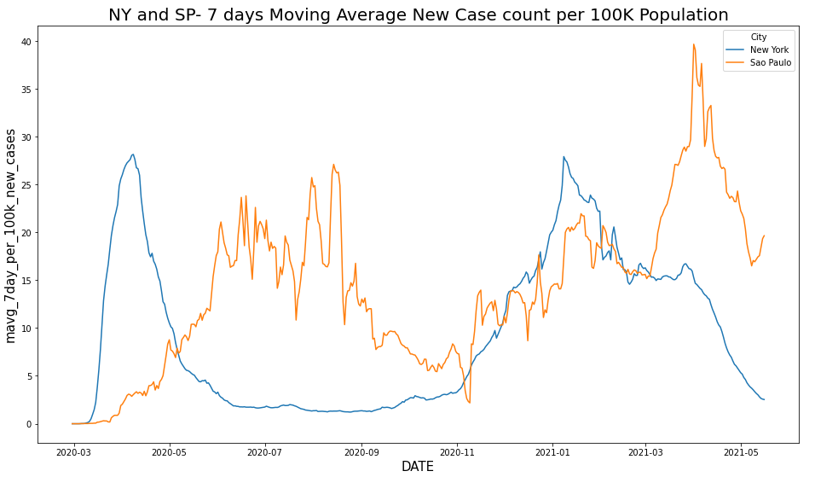
Data Analysis- Compare New Cases
No. of cases per 100K population (7 days average)
Zone B :
doesn't follow the same trend as Zone A, possibly as result of the vaccination rate in both cities. NYC higher vaccination rate than Sao Paulo in the same period.
B
A
C
The period between May 2020 to Nov 2020, we can see that the weather is a variable that can directly impact the number of confirmed Covid Cases, especifically Cold weather.
Zone A:
As New York was going through a hotter weather, Sao Paulo was going through winter and an increase on the number of cases.
Zone C:
In this zone occurs a season transition for both cities; The temperatures are slightly similar. Therefore, the number of cases also follow the same tendency.
Notes:
Some of the key one published over the year are:
www.cebm.net on Mar 23,2020 Do weather conditions influence the transmission of the coronavirus (SARS-CoV-2)?
www.medicalnewstoday.com on Aug. 15,2010 How does weather affect COVID-19?
www.statenews.com on Oct. 21,2020 Covid-19’s wintry mix
www.sciencedaily.com on Nov. 2,2020 Hot or cold, weather alone has no significant effect on COVID-19 spread
www.cbc.ca on Nov. 7, 2020 Winter will help COVID-19 spread more easily
www.huffingtonpost.ca on Jan.7,2021 Does Cold Weather Make COVID-19 Spread More Easily?
www.ctvnews.ca on Sep. 20,2020 COVID-19 appears to spread less in warm and wet climates

Slide 6
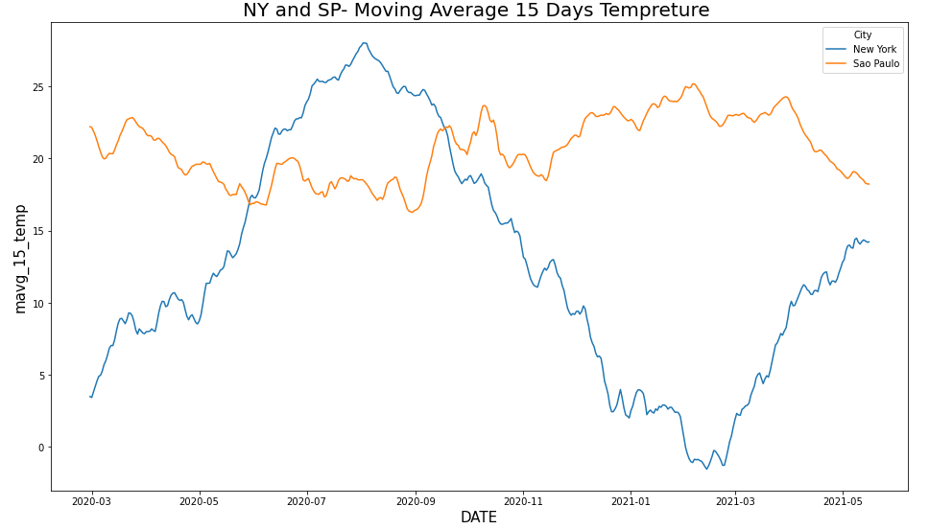
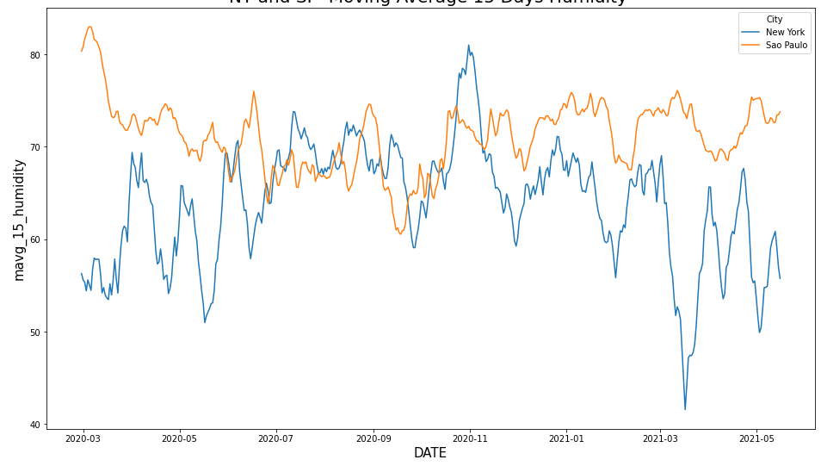
Data Analysis- Compare Weather
Both cities temperature: 15 days average
Both cities humidity: 15 days average
A
NY curve shows that there is a relation between weather and no. cases. Although, for Sao Paulo the 15 days temp avg is slightly linear. The reason of this discrepancy is possibly due to external factors as vaccination rate, lockdown restrictions, etc.
Considering the period selected on Zone A, we can see that humidity is quite similar in both cities, Therefore, this parameter does not impact the number of confirmed cases.
.
Notes:
Some of the key one published over the year are:
www.cebm.net on Mar 23,2020 Do weather conditions influence the transmission of the coronavirus (SARS-CoV-2)?
www.medicalnewstoday.com on Aug. 15,2010 How does weather affect COVID-19?
www.statenews.com on Oct. 21,2020 Covid-19’s wintry mix
www.sciencedaily.com on Nov. 2,2020 Hot or cold, weather alone has no significant effect on COVID-19 spread
www.cbc.ca on Nov. 7, 2020 Winter will help COVID-19 spread more easily
www.huffingtonpost.ca on Jan.7,2021 Does Cold Weather Make COVID-19 Spread More Easily?
www.ctvnews.ca on Sep. 20,2020 COVID-19 appears to spread less in warm and wet climates

Slide 7
Methodology
We ran correlations to validate the strength of the relationship between the variables.
We ran multiple regressions using three cuts of data one for each city and one combined. For the combined, we added “is_New York flag” (1= NY, 0=SP)
Selected date range is from Feb 29,2020 to May 16,2021
Compared Regressions with train and test vs no test.
Trained using Feb 29,2020 to Apr 15,2021 for training
Tested using data from Apr 16 to May 16 2021
Modeling
Variable Selection
15 days average temperature and humidity up to the day before as this is usually the virus incubation period
New cases per 100K to compare same size of population
Moving 7 days average of new cases per 100K to smooth out any reporting anomalies

Slide 8
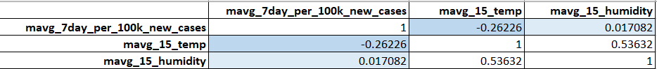
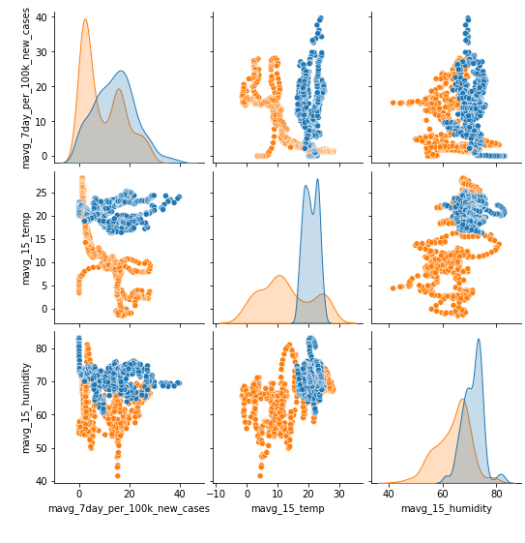
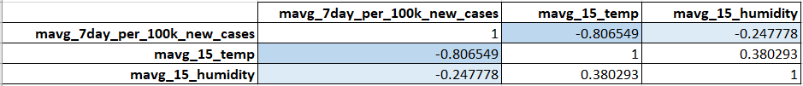
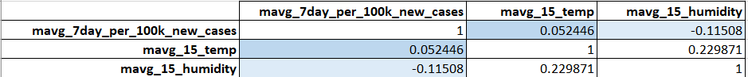
Correlation Analysis- Combined Data
Both cities : New Cases with temperature & Humidity
( 15 days average)
New York only:
New Cases with temperature & Humidity ( 15 days average)
Sao Paulo only:
New Cases with temperature & Humidity ( 15 days average)
Temperature: No. of cases in SP do not follow a trend, while NY does. This confirms that the data makes sense.
Humidity: There is no impact on the number of cases when humidity is considered for the analysis.
New York
Sao Paulo
Notes:
Correlation is a statistical technique that can show whether and how strongly pairs of variables are related/interdependent. When we look at two variables over time if one variable changes how does this affect change in another variable. So Correlation measures to what extent different variables are interdependent.
Positive Correlation: both variables change in the same direction.
Neutral Correlation: No relationship in the change of the variables.
Negative Correlation: variables change in opposite directions.
Correlation coefficient and p-value will tell you the following:
Correlation coefficient
close to +1: Large Positive relationship
close to -1: Large Negative relationship
close to 0: No relationship
P-value
P-value <0.001: Strong certainty in the result
P-value <0.05: Moderate certainty in the result
P-value <0.1: Weak certainty in the result
P-value > 0.1: No certainty in the result
There are several statistics that you can use to quantify correlation- Pearson’s r | Spearman’s ρ (rho) | Kendall’s τ (tau)
Pearson’s coefficient measures linear correlation, while the Spearman and Kendall coefficients compare the ranks of data.
Several conditions have to be met for Pearson correlation:
The variables x and y must have a linear relationship.
Both variables x and y must be numerical (or quantitative). That is, they must represent measurements with no restriction on their level of precision. For example, numbers with many places after the decimal point (such as 11.332 or 0.229) must be possible.
The y values must have a normal distribution for each x, with the same variance at each x.
The Pearson’s correlation coefficient is calculated as the covariance of the two variables divided by the product of the standard deviation of each data sample. It is the normalization of the covariance between the two variables to give an interpretable score.
Pearson’s correlation coefficient is the most common correlation measure out there, but it is not the only one out there. Pearson’s correlation can't be used in all cases. It can be used only when certain conditions are met (those are listed above). If those conditions are not met, the rank correlation can be used (Spearman and Kendall correlation).
Pearson correlation assumes that the data we are comparing is normally distributed. When that assumption is not true, the correlation value is reflecting the true association. Spearman correlation does not assume that data is from a specific distribution, so it is a non-parametric correlation measure.
Spearman’s rank correlation doesn’t require the relationship between the variables x and y to be linear, nor does it require the variables to be numerical. You use Spearman’s rank when the variables are ordinal or/and quantitative. Rather than examining a linear relationship between x and y, Spearman’s rank correlation tests whether two ordinal or/and quantitative variables are dependent.
Note that Spearman’s rank applies to ordinal data only.
Spearman's correlation coefficient, (ρ, also signified by rs) measures the strength and direction of the association between two ranked variables. You interpret the value of Spearman’s rank correlation, ρ the same way you interpret Pearson’s correlation, r. The values of ρ can go between –1 and +1. The higher the magnitude of ρ (in the positive or negative directions), the stronger the relationship.

Slide 9

Regression Models (Train on all 14.5 months data)
1
Regression on Both Cities data | Regressions on NY data
Mean squared error (MSE) | 48.809054423686256
Score/ R-squared (R2) | 0.3177470498469601
Coefficients: | [[ -0.67294798 -0.02484348 -10.39035159]]
Intercept: | [29.84871747]
2
3
Regression on NY data | Regressions on NY data
Mean squared error (MSE) | 26.13768873196065
Score/ R-squared (R2) | 0.5995014517681266
Coefficients: | [[-0.79141555 0.14548759]]
Intercept: | [10.08624177]
Regressions on Sao Paulo data | Regressions on NY data
Mean squared error (MSE) | 62.72028045761924
Score/ R-squared (R2) | 0.05168768077673047
Coefficients: | [[ 0.40810781 -0.46844933]]
Intercept: | [39.0550793]
Notes:
These results are based on weather = temp and humidity

Slide 10


Regression Models (Train on 13.5 months data , Test on 1 month data)
1a
Regression on Both Cities data | Regressions on NY data
Mean squared error (MSE) | 46.20945807691116
Score/ R-squared (R2) | 0.3760756262521734
Coefficients: | [[-0.64739654 -0.0822273 -9.7884102 ]]
Intercept: | [32.88390399]
2a
3a
Regression on NY data | Regressions on NY data
Mean squared error (MSE) | 12.081018410702109
Score/ R-squared (R2) | -0.9917358071630296
Coefficients: | [[-0.78024612 0.11119185]]
Intercept: | [12.3562953]
Regressions on Sao Paulo data | Regressions on NY data
Mean squared error (MSE) | 112.99000223176618
Score/ R-squared (R2) | -7.68849873663247
Coefficients: | [[ 0.6097288 -0.57647938]]
Intercept: | [41.85763192]
Notes:
These results are based on weather = temp and humidity
The highlighted is our selected final model as other models are rejected due to no train and test, and individual cities model not good fit on test data

Slide 11
Conclusion
p vlaues and co-relation showed a relationship between temperate and covid19 new cases
Low R-squared value (37%) means our model is not stong yet. Require further ehancment using either additonal data and/or other methodologies

Slide 12
Recommendations to project expansion
Remove impact of other variables e.g.
Impact of vaccination rate
Impact of the positive cases related to Brazilian mutant, which spread faster than the original.
Impact of Active cases in the city
Run the analysis using additional city data with similar cities.
Add more cities with diverse conditions to understand the behavior of Covid cases compare to different temperatures
Use time series methodologies on the new cases variable before running the regression

Slide 13





Team
Aisha Syed
LinkedIn: https://www.linkedin.com/in/aisha-syed-27506a5/ Email: aishamazhar@hotmail.com
Sushmitha Maddali
LinkedIn: https://www.linkedin.com/in/sushmitha-maddali Email: maddalisushmitha@gmail.com
Archana Narula
LinkedIn: https://www.linkedin.com/in/archana-thakur-narula-536b055/ Email: archanatnarula@gmail.com
Kushal Sharma
LinkedIn: https://www.linkedin.com/in/kushca Email: kushalsharma.ca@gmail.com
Maria Leon
LinkedIn: https://www.linkedin.com/in/marialeon2009/ Email: marietas2009@gmail.com

Slide 14


Slide 15
Appendix: Extra Resources

Slide 16
References
Data Sources
[1] Seade Foundation Statistics Agency of the State of São Paulo
https://saludata.saludcapital.gov.co/osb/index.php/datos-de-salud/enfermedades-trasmisibles/covid19/
[2] NYC Department of Health and Mental Hygiene
https://github.com/nychealth/coronavirus-data
[3] Open Weather Map
www.openweathermap.org
[4] Bogota Health Observatory
https://saludata.saludcapital.gov.co/osb/index.php/datos-de-salud/enfermedades-trasmisibles/covid19/
[5] wCota Github
https://github.com/wcota/covid19br
GitHub Repository for Project Files
https://github.com/archinarula/Group-5-Project

Slide 17
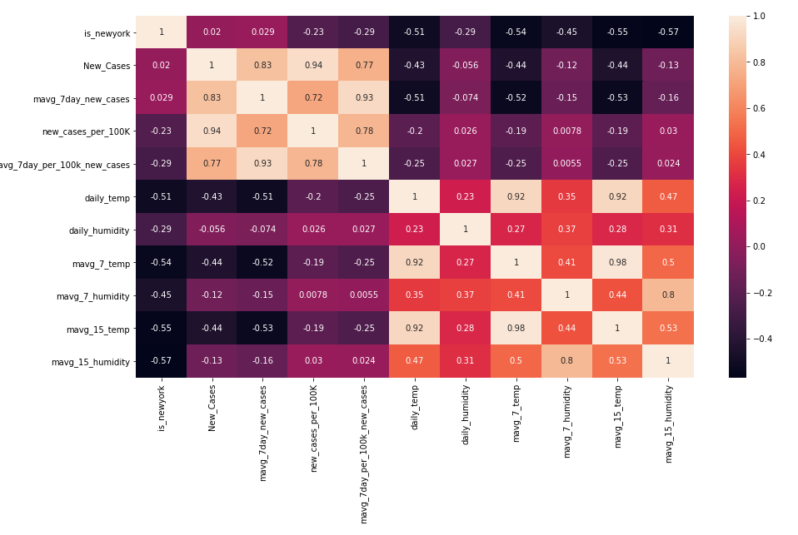
Heatmap of all Variables

Slide 18
Regression Models (Train on all 14.5 months data) – Temperature only
1a
Regression on Both Cities data | Regressions on NY data
Mean squared error (MSE) | 48.82446095385067
Score/ R-squared (R2) | 0.31753169737229314
Coefficients: | [[ -0.67983045 -10.26442788]]
Intercept: | [28.22399894]
2a
3a
Regression on NY data | Regressions on NY data
Mean squared error (MSE) | 26.90417126223218
Score/ R-squared (R2) | 0.5877569113932358
Coefficients: | [[-0.75093355]]
Intercept: | [18.86118889]
Regressions on Sao Paulo data | Regressions on NY data
Mean squared error (MSE) | 65.72903528872156
Score/ R-squared (R2) | 0.006196186621425737
Coefficients: | [[0.28607747]]
Intercept: | [8.25924912]
Notes:
These results are from regression model using all data for training and weather is limited to temperature only

